Slide 1
Drone - Soil Sensor
Communication
Using BLE
Chathura Gunasekara 200193U

Slide 2




Requirements
Point-to-point communication
Reliable and Error Checking protocol
Low power protocol
Economic and Easy Implementation
Notes:
Drone reaches close to the sensor and gets the data from the sensor as planned <- Point to point
Low Power as sensor should function for long periods of time on a single charge as they are placed in remote areas and it is not feasible to retrieve them for charging frequently
Reliable and Error checking -> Transmission occurs once in a specific time duration and this transmission should be reliable else the data received will be errorneous leading to errored predictions
Economic implementation -> Cost effective to implement and the parts required are easily available

Slide 3
Bluetooth Low Energy (BLE)
Transfer data at comparatively high data rate (24 Mbit/s) over short distances (10 m - 100 m)
Low power consumption and ideal for point-to-point data transmission
Bluetooth modules are low cost and are readily available in the market. Many development boards such ESP32 boards contains a Bluetooth modules enabling for a seamless testing process
Error detection and acknowledgement-based communication protocol
Notes:
Compatibility of BLE for the required task

Slide 4
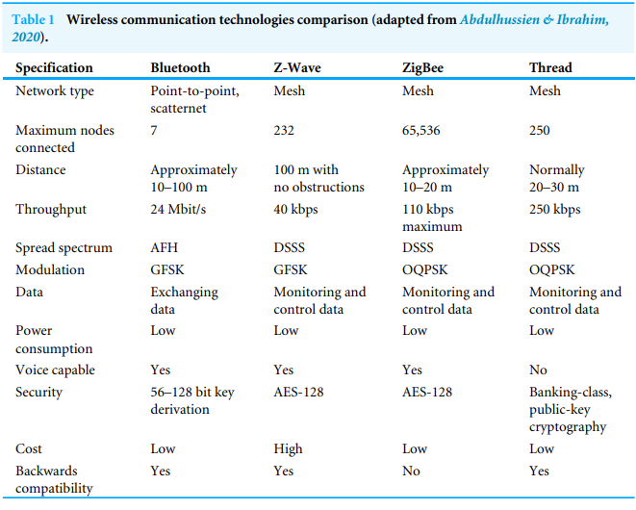
Comparison of existing technologies

Slide 5

BLE Specification highlighted
Network Type: Point-to-Point
Maximum connected devices: 7
Distance: 10m to 100m
Spread spectrum: AFH
Modulation: GFSK Power Consumption: Low

Slide 6
AFH – Adaptive Frequency Hoping
Frequency Hopping Spread Spectrum (FHSS):
Frequency Hopping Pattern: Both transmitter and receiver agree on hopping pattern
Transmission: Each packet is transmitted over a specific frequency channel in a time slot
Synchronization: The receiver must synchronize its hopping pattern with the transmitter
AFH is an extension to FHSS and it enhances the performance of FHSS by dynamically selecting frequency channels based on their quality of transmission
Channel Assessment: network continuously monitor the quality of transmission on different frequency channels
Channel Selection: each device maintains a list of good and bad channels
Hopping Pattern Update: devices periodically exchange information about their channel lists

Slide 7
GFSK – Gaussian Frequency Shift Keying
FSK (Frequency Shift Keying): modulation scheme used in digital communication systems to transmit binary data over a carrier wave. In FSK modulation, different frequencies are used to represent different binary symbols (typically 0 and 1)
Simple Implementation
Robustness to Noise
Spectral Efficiency
Compatibility
GFSK employs a Gaussian filter to shape the frequency transitions between the "0" and "1" frequencies. The Gaussian filter smooths the abrupt transitions, reducing the interference generated by rapid frequency changes

Slide 8
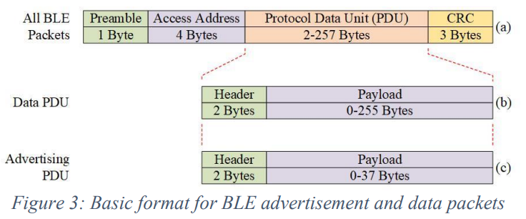
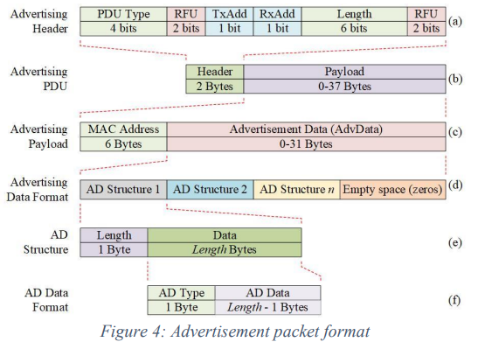
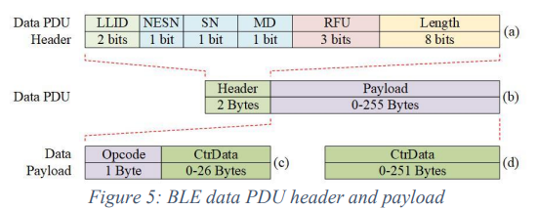
BLE Packet Structure

Slide 9
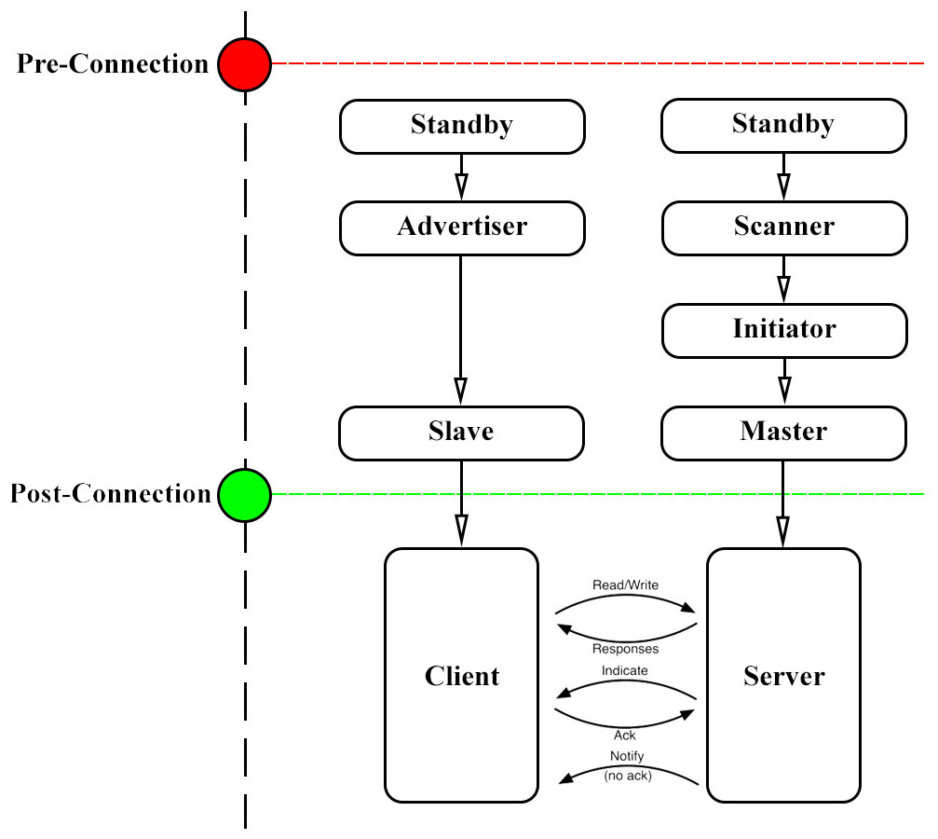
BLE Point-to-Point Connection State Diagram

Slide 10
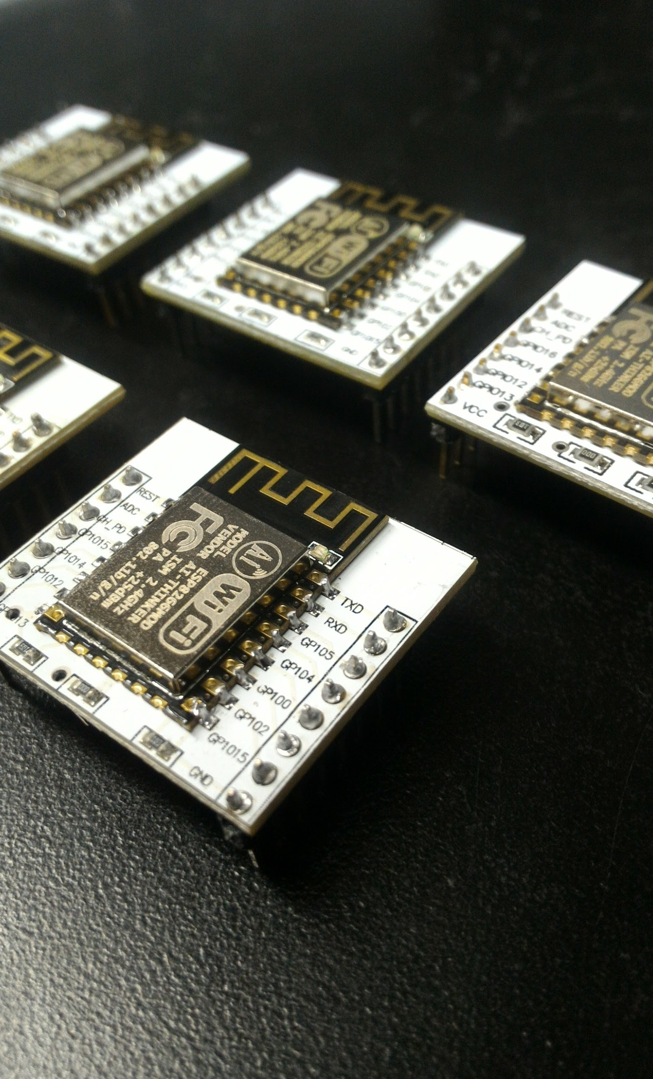
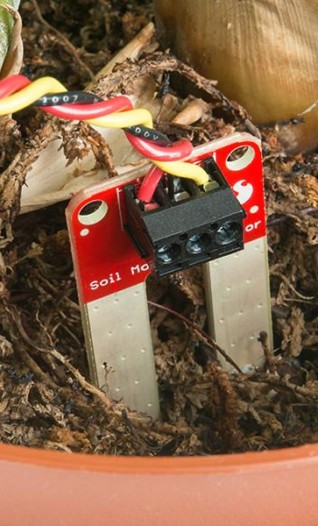
Setting up a test network
Equipments: ESP32 boards, wires, batteries, OLED display, Soil sensor*
Parameters to test:
Data transmission test
Handling disturbances in the environment
Power Usage test

Slide 11
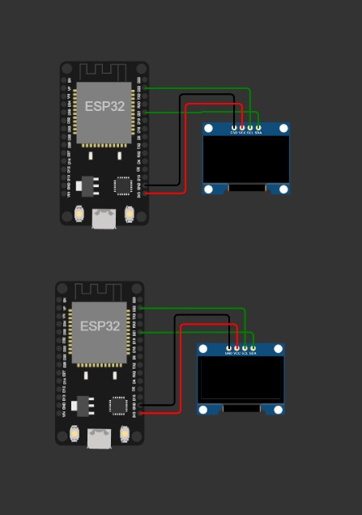
Basic Setup
Configure 2 ESP boards to work as a client and a server using the BLE protocol.
First validate the code using a local machine and then setup each with an independent power supply
The 2 boards are positioned at a distance of 1m (or less) apart and the test is executed.
For the initial Setup we will be using the serial monitor to monitor the test results.

Slide 12
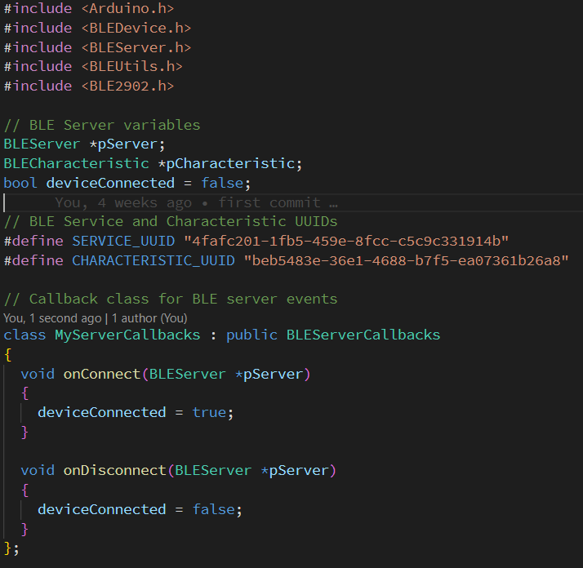
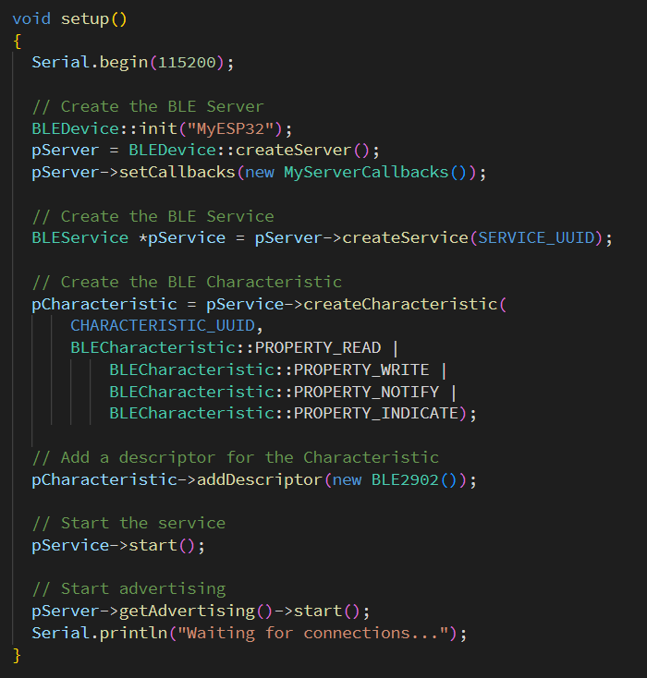
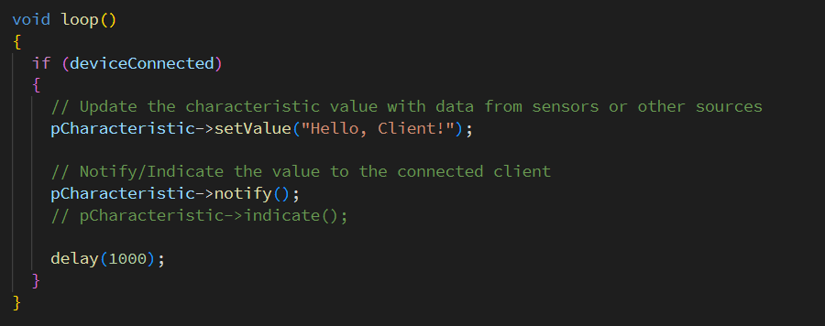
Basic Client-Server Setup
Server Code

Slide 13
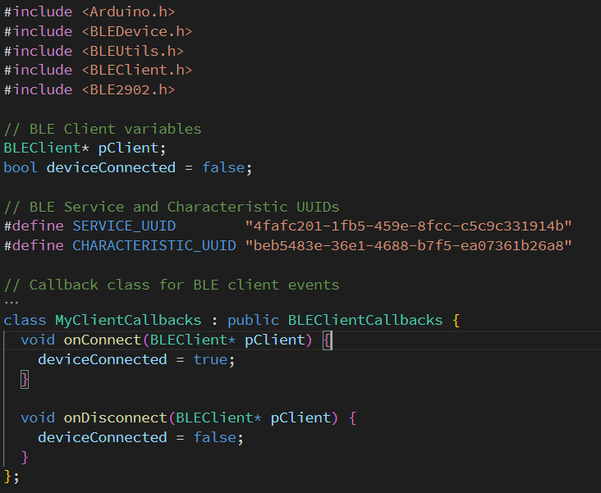
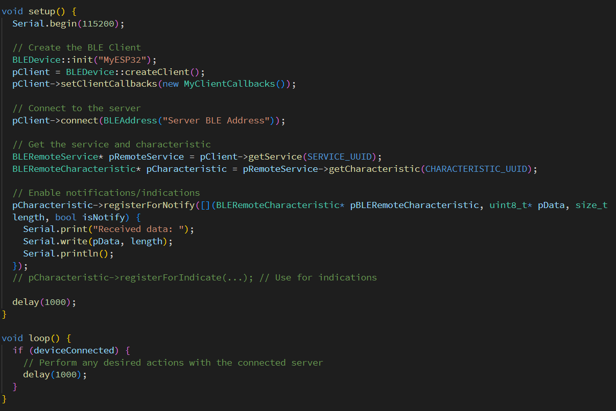
Basic Client-Server Setup
Client Code

Slide 14
Data Transmission test
✅ Test A : The client transmits a known message and the server displays the received message.
✅ Test B : The client transmits the time (accurate to the nearest second) in a string form and the server displays it. It is planned to increase the accuracy of the time measurement to milliseconds and test for the accurate of transmission
🔃 Test C : Move the client node steadily away from the server and record the distance over which the transmission is accurate
🔃 Test D : Move the client node in an oscillatory motion and record the accuracy of the transferred data
🔃 Test E : Move the client node suddenly and record the accuracy of the subsequent data transmissions.

Slide 15
Handling Disturbances in the Environment
🔃 Test A: Setup multiple Bluetooth devices in a nearby vicinity transmitting signals and check if the data transferred by the sensor to the drone is still accurate
🔃 Test B : Place a solid object between the 2 nodes and check for accuracy in transmitted data. Vary the physical parameters of the obstacle and check for the accuracy of the transmitted data
🔃 Test C : Place the sensor within a lump of soil and conduct the test again

Slide 16
Power Usage Test
🔃 Test A: Operate the client and server to transmit data over a specified time period and record the current consumption and determine the power usage both nodes
🔃 Test B: Operate the server in intermittent sleep modes and repeat the above step

Slide 17
References
A Summary of Bluetooth Low Energy John Harris, Logan Small, Matt Hopkins, Nathaniel de Lautour Defence Technology Agency (DTA), New Zealand Defence Force (NZDF), April 2020.
An efficient networking solution for extending and controlling wireless sensor networks using low-energy technologies Mostafa Ibrahim Labib1 , Mohamed ElGazzar2 , Atef Ghalwash1 and Sarah Nabil AbdulKader1,3 1 Computer Science, Faculty of Computers and Artificial Intelligence, Helwan University, Cairo, Egypt 2Vodafone Company, Cairo, Egypt 3 Computer Science, Faculty of Computer Studies, Arab Open University, Cairo, Egypt

Slide 18
Thank you.

